Slide 1
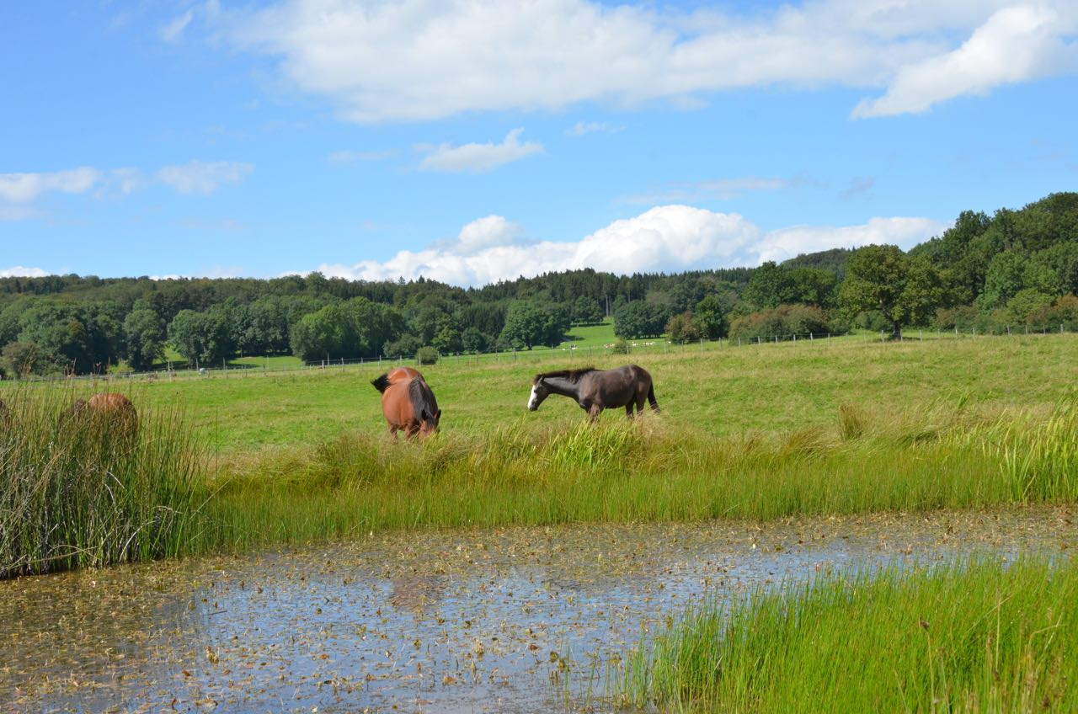
Lumière Breeding Syndicate
presenting
Forlano
Forcing Bull
Elevage Détouillon,
Longechaux, Franche Comté

Slide 2
Forlano
(Papal Bull – Floriana
by Seattle Dancer)
Elevage Détouillon,
Longechaux, Franche Comté

Slide 3
Pedigree Forlano

Slide 4
Forlano

Slide 5
Forlano

Slide 6
Forlano

Slide 7
Forlano

Slide 8
Forlano

Slide 9
Forlano

Slide 10
Forlano

Slide 11
Forlano

Slide 12
Forlano

Slide 13
Forlano

Slide 14
Forlano

Slide 15
Forlano

Slide 16
Forcing Bull
(Papal Bull – Florice
by Lord of England)
Elevage Détouillon,
Longechaux, Franche Comté

Slide 17
Pedigree Forcing Bull

Slide 18
Forcing Bull

Slide 19
Forcing Bull

Slide 20
Forcing Bull

Slide 21
Forcing Bull

Slide 22
Forcing Bull

Slide 23
Forcing Bull

Slide 24
Forcing Bull

Slide 25
Forcing Bull

Slide 26
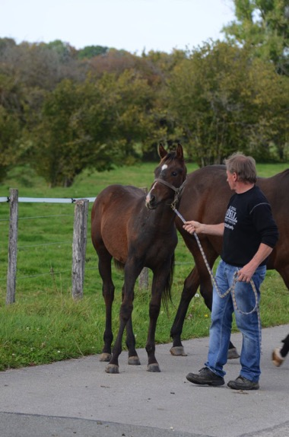
Forcing Bull

Slide 27
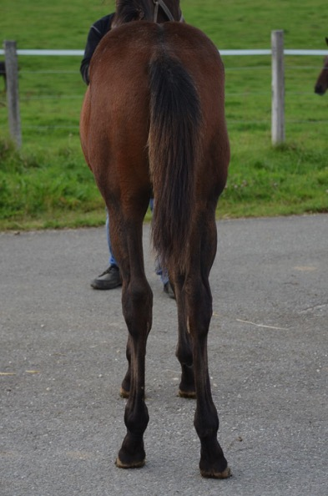
Forcing Bull

Slide 28
Forcing Bull

Slide 29
Forcing Bull

Slide 30
Forcing Bull

